Slide 1
K8s. Installation
Workshop

Slide 2
Agenda
Check access
Install kubectl
Access to dashboard
Access use kubectl

Slide 3
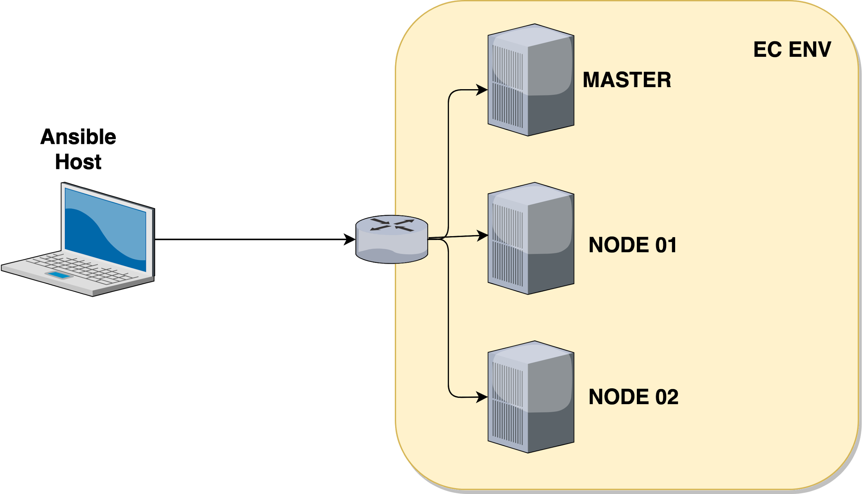
HLD

Slide 4
Final result
Access by kubectl
Access to dashboard

Slide 5
Kubectl
Install https://kubernetes.io/docs/tasks/tools/install-kubectl/
Cheatsheet: https://kubernetes.io/docs/reference/kubectl/cheatsheet/
Examples

Slide 6
Let’s start

Slide 7
K3s. Lightweight Kubernetes
Packaged as a single binary
Lightweight storage backend
Secure by default with reasonable defaults for lightweight environments.
Simple but powerful “batteries-included” features have been added
Operation of all Kubernetes control plane components is encapsulated in a single binary and process
External dependencies have been minimized
K3s packages required dependencies, including:
Containerd, Flannel, CoreDNS
Host utilities (iptables, socat, etc)
Ingress controller (traefik)
Embedded service loadbalancer
Embedded network policy controller

Slide 8
K3s. Lightweight Kubernetes
Good for:
CI
Development
ARM
Embedding K8s
https://k3s.io/

Slide 9
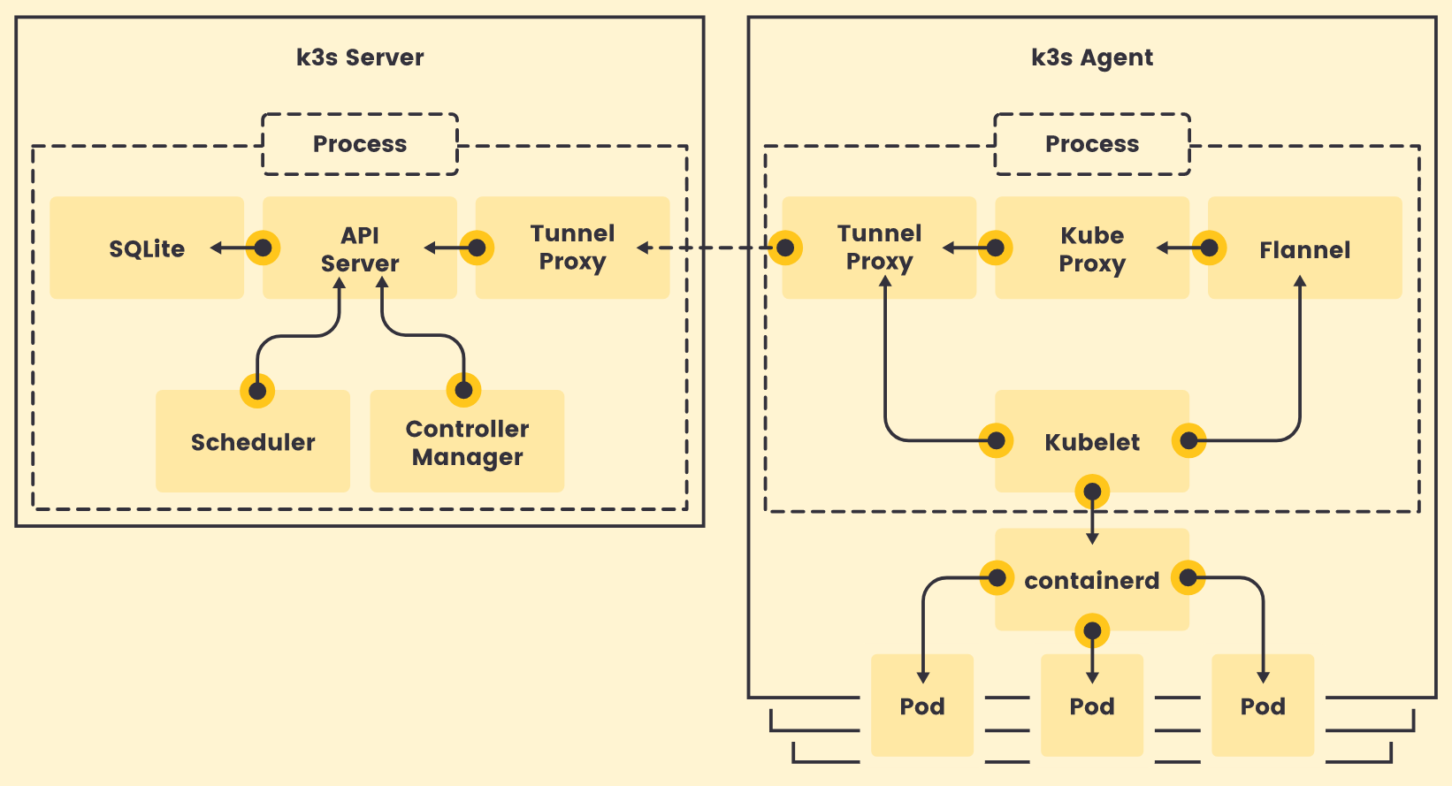
K3s
https://k3s.io/

Slide 10
Let’s start

Slide 11
K8s. To read
https://kubernetes.io/docs/setup/production-environment/tools/kubespray/
https://kubernetes.io/docs/tutorials/
https://github.com/kubernetes-sigs/kubespray

